Slide 1
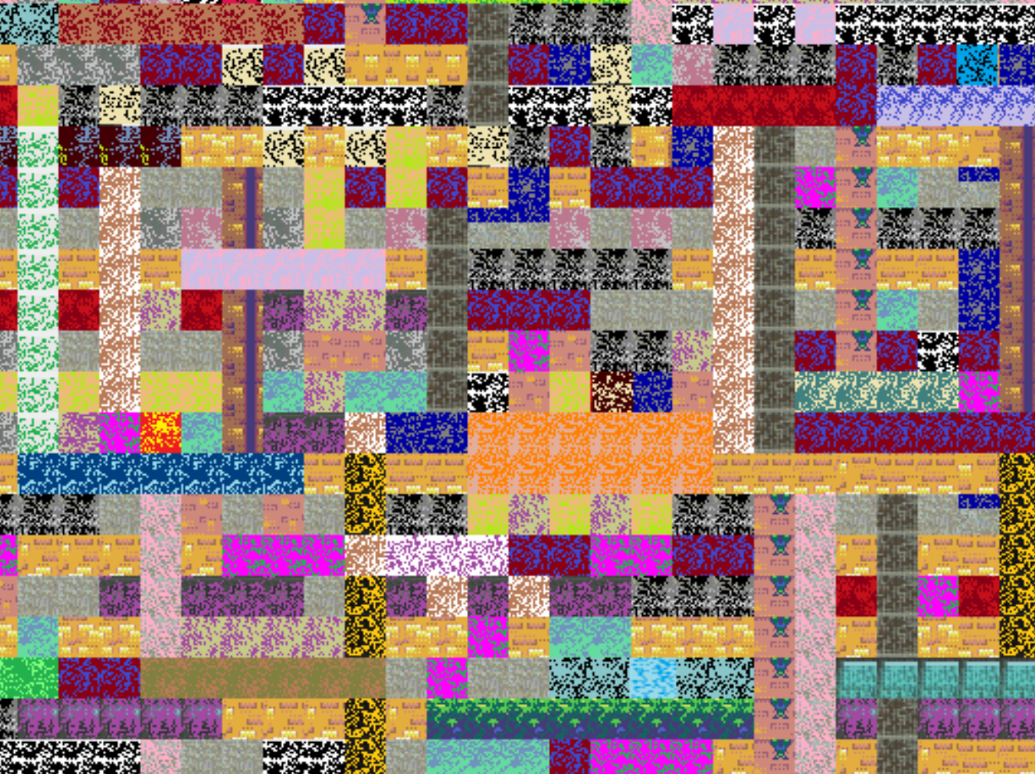
Warm-up as you walk in
https://high-level-4.herokuapp.com/experiment
https://rach0012.github.io/humanRL_website/

Slide 2
Announcements
Assignments:
HW8
Due Tue 3/26, 10 pm
P4
Due Thu 3/28, 10 pm
HW9 (written)
Plan: Out tomorrow, due Tue 4/2

Slide 3
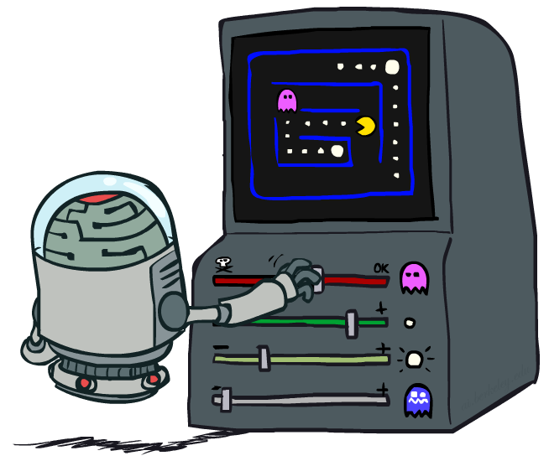
AI: Representation and Problem Solving
Reinforcement Learning II
Instructors: Pat Virtue & Stephanie Rosenthal
Slide credits: CMU AI and http://ai.berkeley.edu

Slide 4

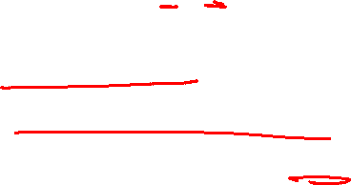
Reinforcement Learning
We still assume an MDP:
A set of states s ∈ S
A set of actions (per state) A
A model T(s,a,s’)
A reward function R(s,a,s’)
Still looking for a policy π(s)
New twist: don’t know T or R, so must try out actions
Big idea: Compute all averages over T using sample outcomes

Slide 5

Temporal Difference Learning

Slide 6
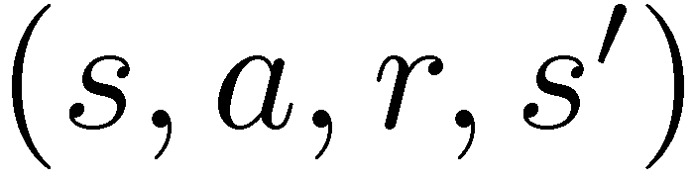

Model-Free Learning
s
Model-free (temporal difference) learning
Experience world through episodes
Update estimates each transition
Over time, updates will mimic Bellman updates
a
s, a
r
s’
a’
s’, a’
s’’

Slide 7
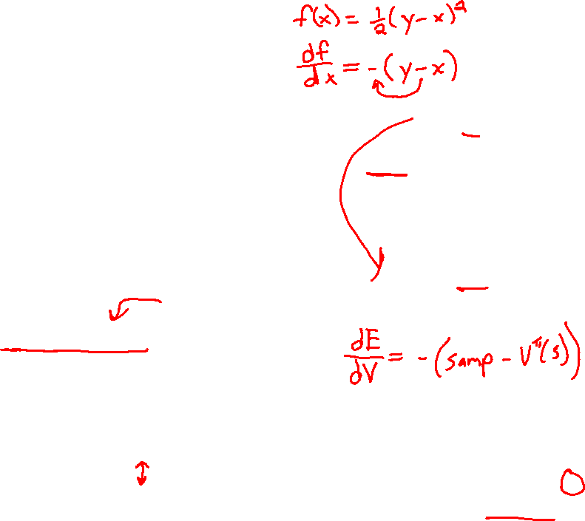
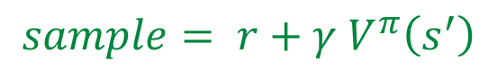
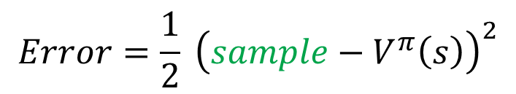
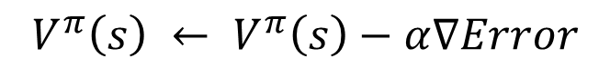
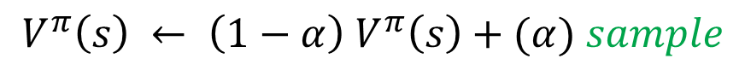
Temporal Difference Learning
Big idea: learn from every experience!
Update V(s) each time we experience a transition (s, a, s’, r)
Likely outcomes s’ will contribute updates more often
Temporal difference learning of values
Policy still fixed, still doing evaluation!
Move values toward value of whatever successor occurs: running average
s
π(s)
s, π(s)
s’
Sample of V(s):
$$sample= r+γ V^{π}\left(s^{′}\right)$$
Update to V(s):
$$V^{π}\left(s\right) ← {\left(1−α\right) V}^{π}\left(s\right)+(α) sample$$
Same update:
$$V^{π}\left(s\right) ← V^{π}(s) +α \left[sample− V^{π}\left(s\right)\right]$$
$$Error=\frac{1}{2} {\left(sample−V^{π}\left(s\right)\right)}^{2}$$
Same update:
$$V^{π}\left(s\right) ← V^{π}\left(s\right)−α∇Error$$

Slide 8
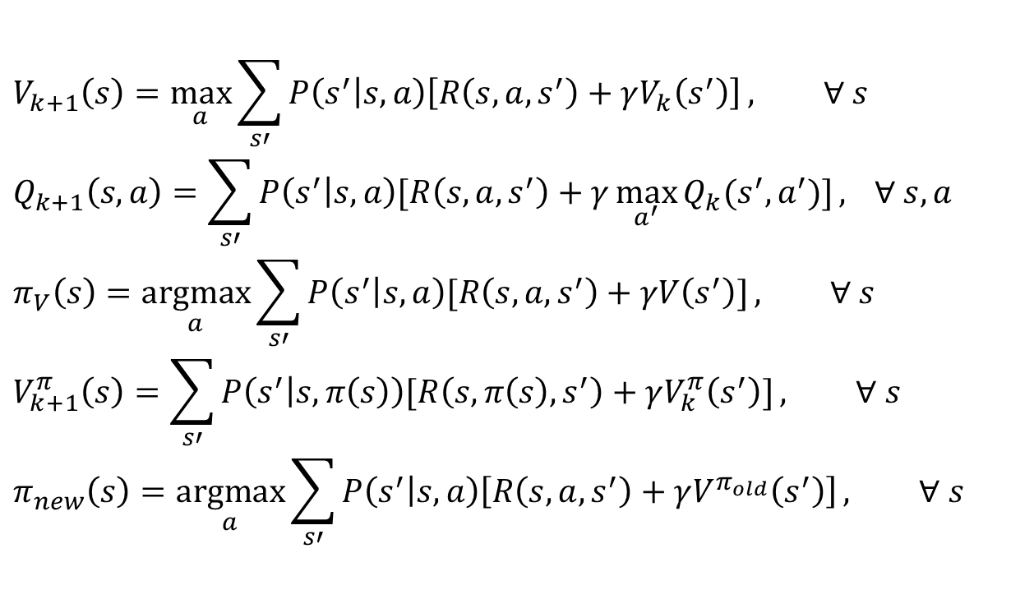
Piazza Poll 1
TD update:
$$V^{π}\left(s\right) = V^{π}(s) +α \left[r+γ V^{π}\left(s^{′}\right)− V^{π}\left(s\right)\right]$$
Which converts TD values into a policy?
$$V_{k+1}\left(s\right)=\max_{a}{\sum_{s′}{P\left(s^{′} | s,a\right)\left[R\left(s,a,s^{′}\right)+γV_{k}\left(s^{′}\right)\right]}}, ∀ s$$
$$Q_{k+1}\left(s,a\right)=\sum_{s′}{P\left(s^{′} | s,a\right)[R\left(s,a,s^{′}\right)+γ\max_{a^{′}}{Q_{k}(s^{′},a^{′})]}, } ∀ s,a$$
$$π_{V}\left(s\right)=\underset{a}{argmax}{\sum_{s′}{P\left(s^{′} | s,a\right)[R\left(s,a,s^{′}\right)+γV\left(s^{′}\right)]}}, ∀ s$$
$$V_{k+1}^{π}\left(s\right)=\sum_{s′}{P\left(s^{′} | s,π\left(s\right)\right)[R\left(s,π\left(s\right),s^{′}\right)+γV_{k}^{π}\left(s^{′}\right)]}, ∀ s$$
$$π_{new}\left(s\right)=\underset{a}{argmax}{\sum_{s′}{P\left(s^{′} | s,a\right)\left[R\left(s,a,s^{′}\right)+γV^{π_{old}}\left(s^{′}\right)\right]}}, ∀ s$$
Value iteration:
Q-iteration:
Policy extraction:
Policy evaluation:
Policy improvement:

Slide 9
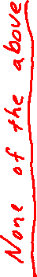
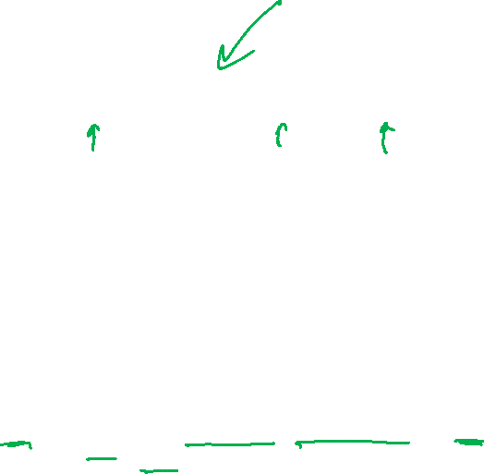
Piazza Poll 1
TD update:
$$V^{π}\left(s\right) = V^{π}(s) +α \left[r+γ V^{π}\left(s^{′}\right)− V^{π}\left(s\right)\right]$$
Which converts TD values into a policy?
$$V_{k+1}\left(s\right)=\max_{a}{\sum_{s′}{P\left(s^{′} | s,a\right)\left[R\left(s,a,s^{′}\right)+γV_{k}\left(s^{′}\right)\right]}}, ∀ s$$
$$Q_{k+1}\left(s,a\right)=\sum_{s′}{P\left(s^{′} | s,a\right)[R\left(s,a,s^{′}\right)+γ\max_{a^{′}}{Q_{k}(s^{′},a^{′})]}, } ∀ s,a$$
$$π_{V}\left(s\right)=\underset{a}{argmax}{\sum_{s′}{P\left(s^{′} | s,a\right)[R\left(s,a,s^{′}\right)+γV\left(s^{′}\right)]}}, ∀ s$$
$$V_{k+1}^{π}\left(s\right)=\sum_{s′}{P\left(s^{′} | s,π\left(s\right)\right)[R\left(s,π\left(s\right),s^{′}\right)+γV_{k}^{π}\left(s^{′}\right)]}, ∀ s$$
$$π_{new}\left(s\right)=\underset{a}{argmax}{\sum_{s′}{P\left(s^{′} | s,a\right)\left[R\left(s,a,s^{′}\right)+γV^{π_{old}}\left(s^{′}\right)\right]}}, ∀ s$$
Value iteration:
Q-iteration:
Policy extraction:
Policy evaluation:
Policy improvement:

Slide 10
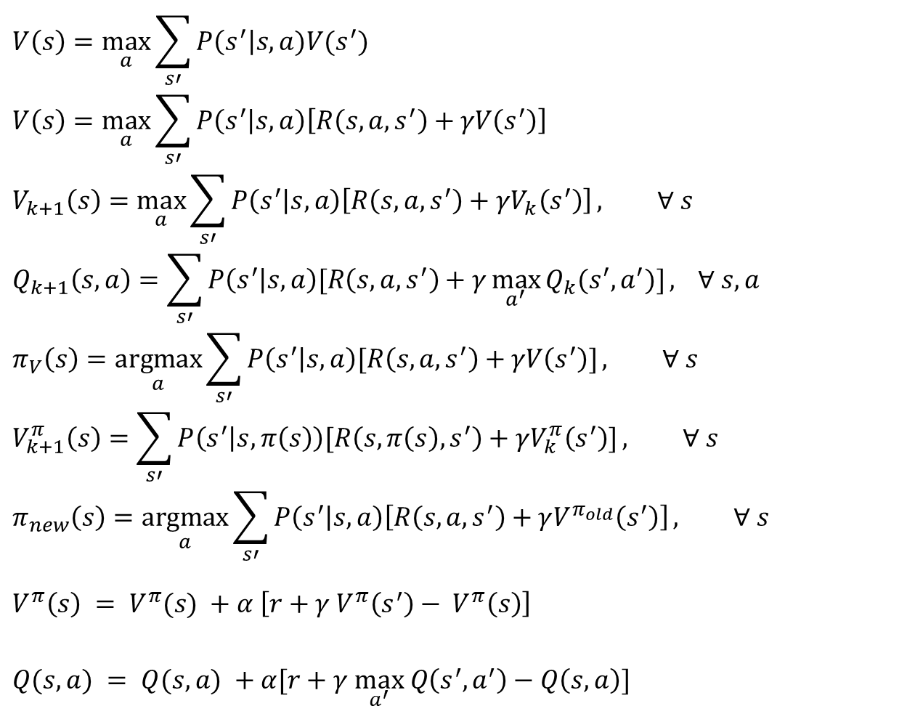
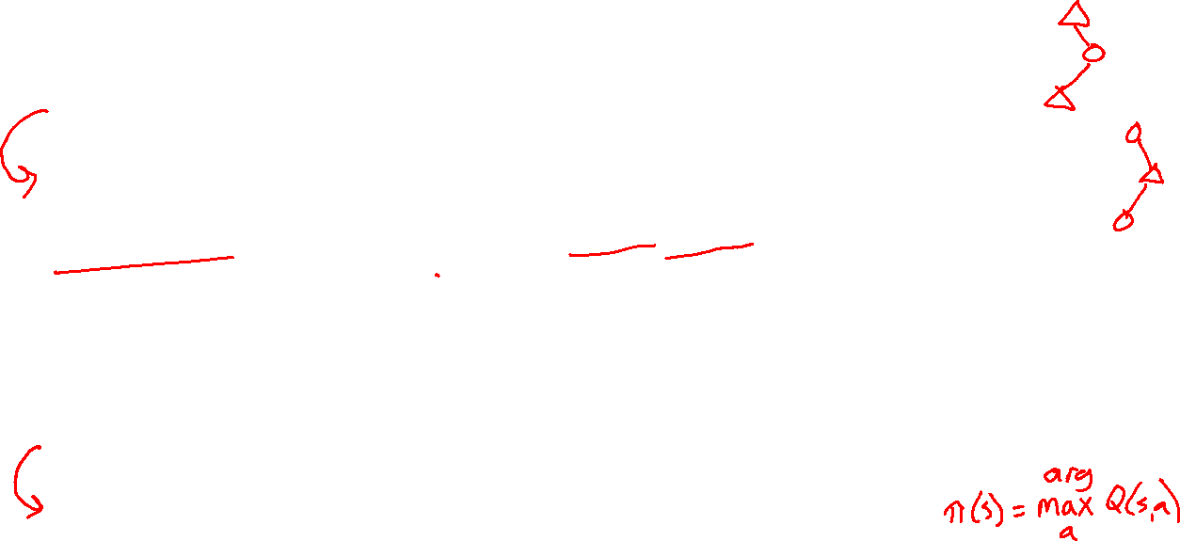
MDP/RL Notation
Standard expectimax:
$$V\left(s\right)=\max_{a}{\sum_{s′}{P\left(s^{′}\right|s,a)V(s^{′})}}$$
$$V\left(s\right)=\max_{a}{\sum_{s′}{P\left(s^{′} | s,a\right)\left[R\left(s,a,s^{′}\right)+γV\left(s^{′}\right)\right]}}$$
$$V_{k+1}\left(s\right)=\max_{a}{\sum_{s′}{P\left(s^{′} | s,a\right)\left[R\left(s,a,s^{′}\right)+γV_{k}\left(s^{′}\right)\right]}}, ∀ s$$
$$Q_{k+1}\left(s,a\right)=\sum_{s′}{P\left(s^{′} | s,a\right)[R\left(s,a,s^{′}\right)+γ\max_{a^{′}}{Q_{k}(s^{′},a^{′})]}, } ∀ s,a$$
$$π_{V}\left(s\right)=\underset{a}{argmax}{\sum_{s′}{P\left(s^{′} | s,a\right)[R\left(s,a,s^{′}\right)+γV\left(s^{′}\right)]}}, ∀ s$$
$$V_{k+1}^{π}\left(s\right)=\sum_{s′}{P\left(s^{′} | s,π\left(s\right)\right)[R\left(s,π\left(s\right),s^{′}\right)+γV_{k}^{π}\left(s^{′}\right)]}, ∀ s$$
$$π_{new}\left(s\right)=\underset{a}{argmax}{\sum_{s′}{P\left(s^{′} | s,a\right)\left[R\left(s,a,s^{′}\right)+γV^{π_{old}}\left(s^{′}\right)\right]}}, ∀ s$$
$$V^{π}\left(s\right) = V^{π}(s) +α \left[r+γ V^{π}\left(s^{′}\right)− V^{π}\left(s\right)\right]$$
$Q(s,a) = Q(s,a) +α[r+γ \max_{a^{′}} Q\left(s^{′},a^{′}\right)−Q\left(s, a\right)]$
Bellman equations:
Value iteration:
Q-iteration:
Policy extraction:
Policy evaluation:
Policy improvement:
Value (TD) learning:
Q-learning:

Slide 11
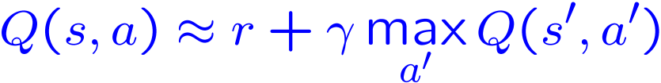
Q-Learning
We’d like to do Q-value updates to each Q-state:
But can’t compute this update without knowing T, R
Instead, compute average as we go
Receive a sample transition (s,a,r,s’)
This sample suggests
But we want to average over results from (s,a) (Why?)
So keep a running average

Slide 12


Q-Learning Properties
Amazing result: Q-learning converges to optimal policy -- even if you’re acting suboptimally!
This is called off-policy learning
Caveats:
You have to explore enough
You have to eventually make the learning rate
small enough
… but not decrease it too quickly
Basically, in the limit, it doesn’t matter how you select actions (!)
[Demo: Q-learning – auto – cliff grid (L11D1)]

Slide 13
Demo Q-Learning Auto Cliff Grid
[Demo: Q-learning – auto – cliff grid (L11D1)]

Slide 14
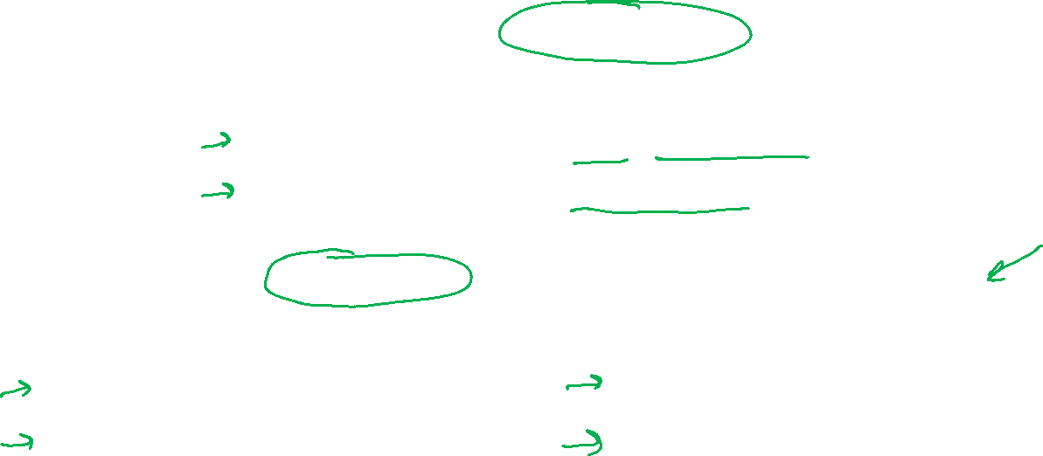
The Story So Far: MDPs and RL
Known MDP: Offline Solution
Goal Technique
Compute V*, Q*, π* Value / policy iteration
Evaluate a fixed policy π Policy evaluation
Unknown MDP: Model-Based
Unknown MDP: Model-Free
Goal Technique
Compute V*, Q*, π* VI/PI on approx. MDP
Evaluate a fixed policy π PE on approx. MDP
Goal Technique
Compute V*, Q*, π* Q-learning
Evaluate a fixed policy π TD/Value Learning

Slide 15
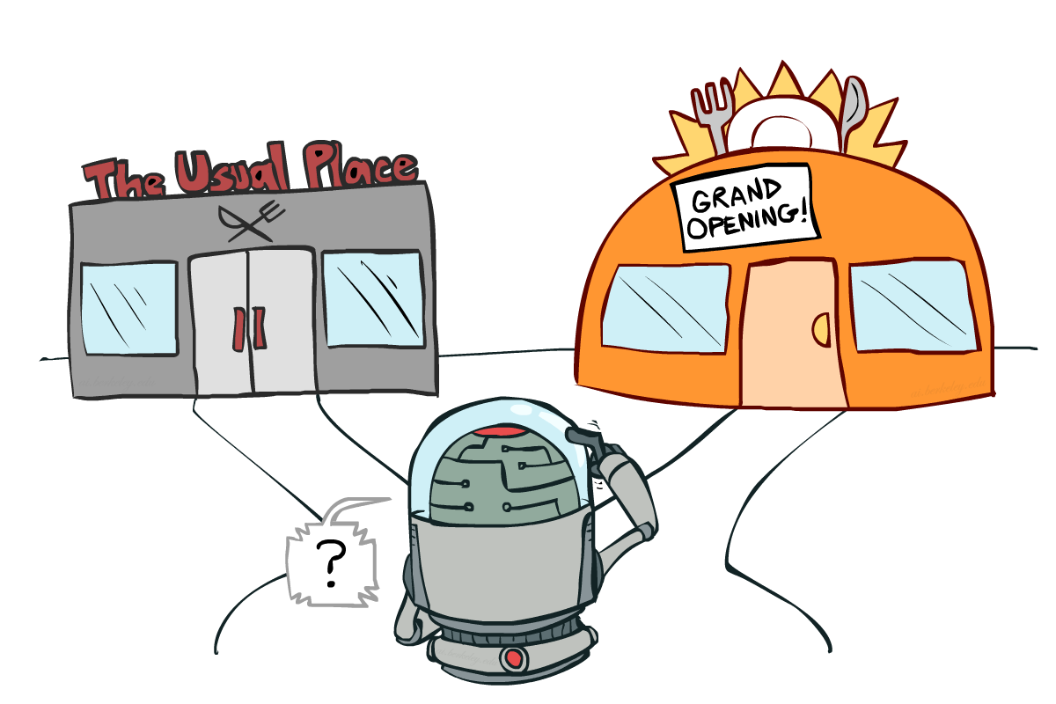
Exploration vs. Exploitation

Slide 16

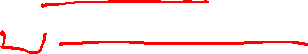
How to Explore?
Several schemes for forcing exploration
Simplest: random actions (ε-greedy)
Every time step, flip a coin
With (small) probability ε, act randomly
With (large) probability 1-ε, act on current policy
Problems with random actions?
You do eventually explore the space, but keep thrashing around once learning is done
One solution: lower ε over time
Another solution: exploration functions
[Demo: Q-learning – manual exploration – bridge grid (L11D2)] [Demo: Q-learning – epsilon-greedy -- crawler (L11D3)]

Slide 17
Demo Q-learning – Manual Exploration – Bridge Grid

Slide 18
Demo Q-learning – Epsilon-Greedy – Crawler

Slide 19
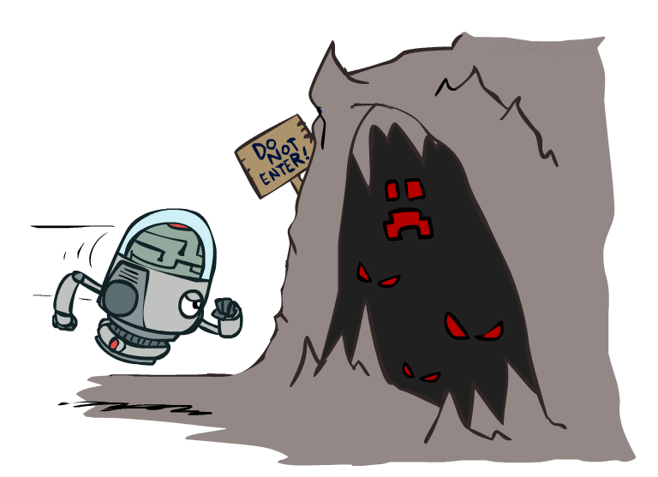
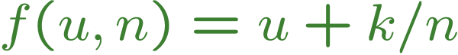
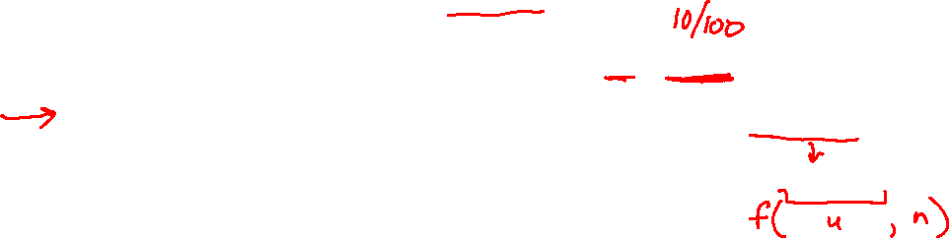
Exploration Functions
When to explore?
Random actions: explore a fixed amount
Better idea: explore areas whose badness is not
(yet) established, eventually stop exploring
Exploration function
Takes a value estimate u and a visit count n, and
returns an optimistic utility, e.g.
Note: this propagates the “bonus” back to states that lead to unknown states as well!
Regular Q-Update:
Modified Q-Update:
[Demo: exploration – Q-learning – crawler – exploration function (L11D4)]

Slide 20
Demo Q-learning – Exploration Function – Crawler

Slide 21
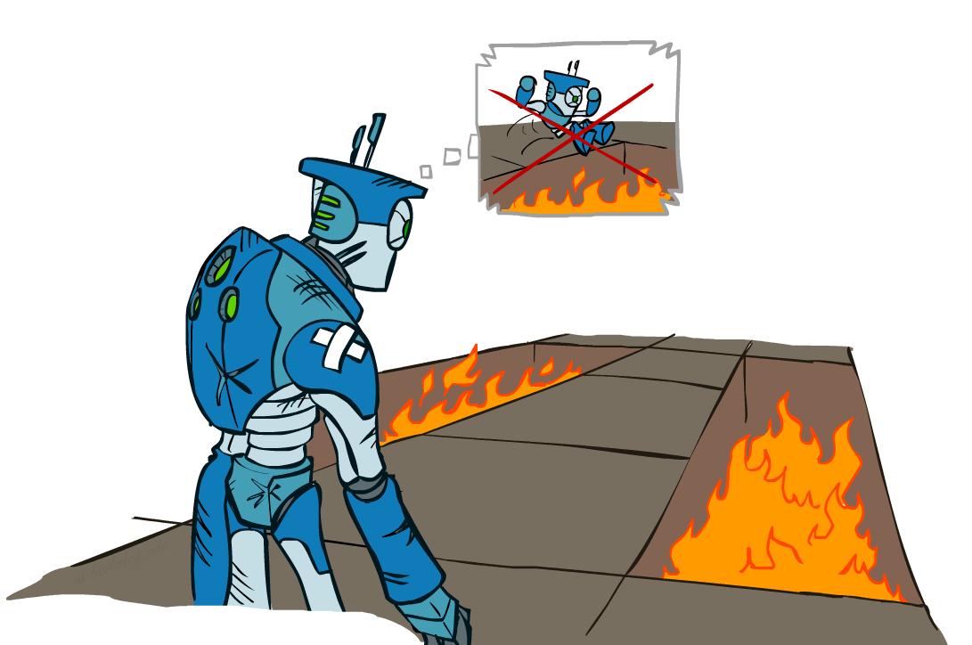
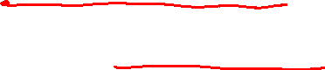
Regret
Even if you learn the optimal policy, you still make mistakes along the way!
Regret is a measure of your total mistake cost: the difference between your (expected) rewards, including youthful suboptimality, and optimal (expected) rewards
Minimizing regret goes beyond learning to be optimal – it requires optimally learning to be optimal
Example: random exploration and exploration functions both end up optimal, but random exploration has higher regret

Slide 22
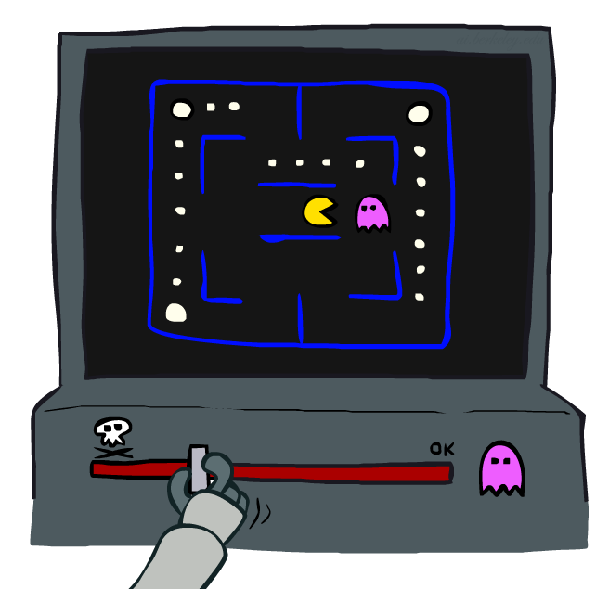
Approximate Q-Learning
Notes:
:34 in, :40 to go

Slide 23


Generalizing Across States
Basic Q-Learning keeps a table of all q-values
In realistic situations, we cannot possibly learn about every single state!
Too many states to visit them all in training
Too many states to hold the q-tables in memory
Instead, we want to generalize:
Learn about some small number of training states from experience
Generalize that experience to new, similar situations
This is a fundamental idea in machine learning, and we’ll see it over and over again
[demo – RL pacman]

Slide 24
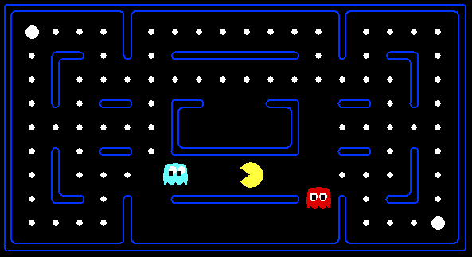



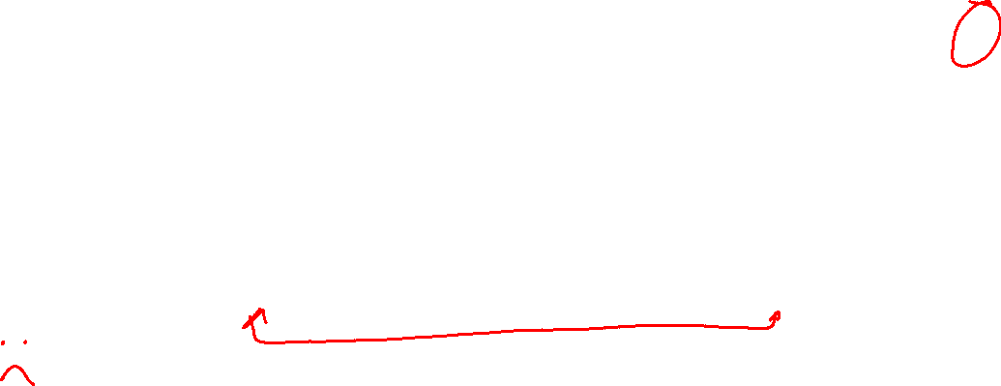
Example: Pacman
Let’s say we discover through experience that this state is bad:
In naïve q-learning, we know nothing about this state:
Or even this one!
[Demo: Q-learning – pacman – tiny – watch all (L11D5)]
[Demo: Q-learning – pacman – tiny – silent train (L11D6)]
[Demo: Q-learning – pacman – tricky – watch all (L11D7)]

Slide 25
Demo Q-Learning Pacman – Tiny – Watch All

Slide 26
Demo Q-Learning Pacman – Tiny – Silent Train

Slide 27
Demo Q-Learning Pacman – Tricky – Watch All

Slide 28
Feature-Based Representations
Solution: describe a state using a vector of features (properties)
Features are functions from states to real numbers (often 0/1) that capture important properties of the state
Example features:
Distance to closest ghost
Distance to closest dot
Number of ghosts
1 / (dist to dot)²
Is Pacman in a tunnel? (0/1)
…… etc.
Is it the exact state on this slide?
Can also describe a q-state (s, a) with features (e.g. action moves closer to food)

Slide 29
Linear Value Functions
Using a feature representation, we can write a q function (or value function) for any state using a few weights:
V_{w}(s) = w₁f₁(s) + w₂f₂(s) + … + w_{n}f_{n}(s)
Q_{w}(s,a) = w₁f₁(s,a) + w₂f₂(s,a) + … + w_{n}f_{n}(s,a)
Advantage: our experience is summed up in a few powerful numbers
Disadvantage: states may share features but actually be very different in value!

Slide 30
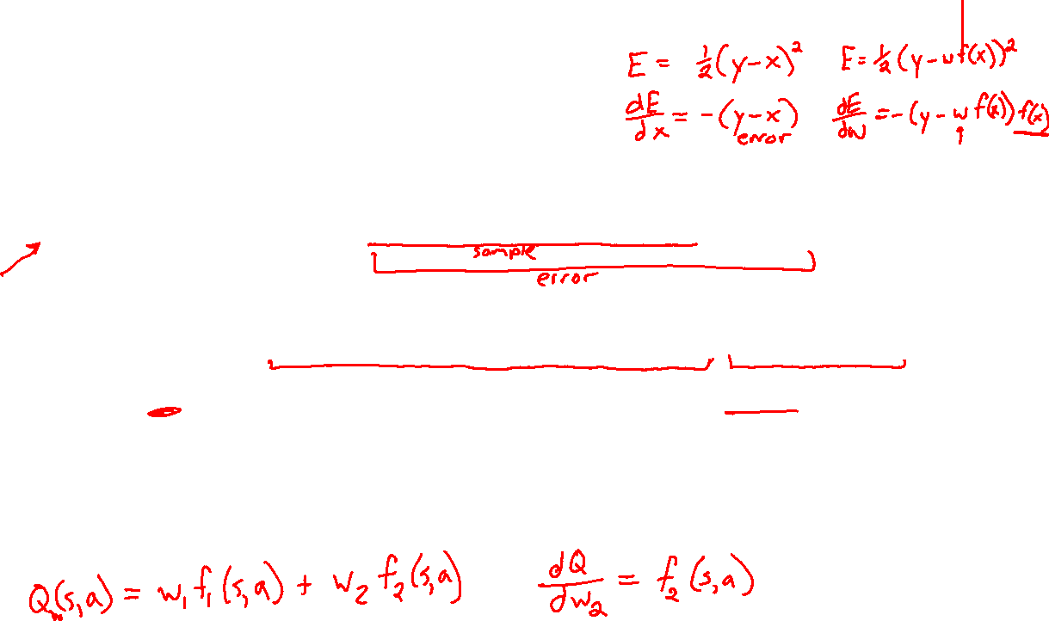
Updating a linear value function
Original Q learning rule tries to reduce prediction error at s, a:
Q(s,a) ← Q(s,a) + α ⋅ [R(s,a,s’) + γ max_{a’} Q (s’,a’) - Q(s,a) ]
Instead, we update the weights to try to reduce the error at s, a:
w_{i} ← w_{i} + α ⋅ [R(s,a,s’) + γ max_{a’} Q (s’,a’) - Q(s,a) ] ∂Q_{w}(s,a)/∂w_{i}
= w_{i} + α ⋅ [R(s,a,s’) + γ max_{a’} Q (s’,a’) - Q(s,a) ] f_{i}(s,a)

Slide 31
Updating a linear value function
Original Q learning rule tries to reduce prediction error at s, a:
Q(s,a) ← Q(s,a) + α ⋅ [R(s,a,s’) + γ max_{a’} Q (s’,a’) - Q(s,a) ]
Instead, we update the weights to try to reduce the error at s, a:
w_{i} ← w_{i} + α ⋅ [R(s,a,s’) + γ max_{a’} Q (s’,a’) - Q(s,a) ] ∂Q_{w}(s,a)/∂w_{i}
= w_{i} + α ⋅ [R(s,a,s’) + γ max_{a’} Q (s’,a’) - Q(s,a) ] f_{i}(s,a)
Qualitative justification:
Pleasant surprise: increase weights on +ve features, decrease on –ve ones
Unpleasant surprise: decrease weights on +ve features, increase on –ve ones

Slide 32
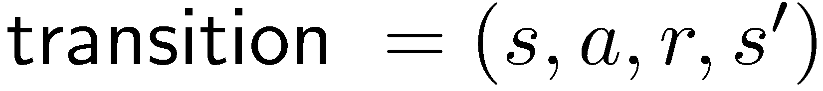

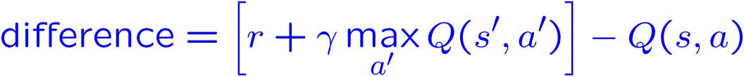
Approximate Q-Learning
Q-learning with linear Q-functions:
Intuitive interpretation:
Adjust weights of active features
E.g., if something unexpectedly bad happens, blame the features that were on: disprefer all states with that state’s features
Formal justification: online least squares
Exact Q’s
Approximate Q’s

Slide 33
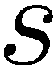
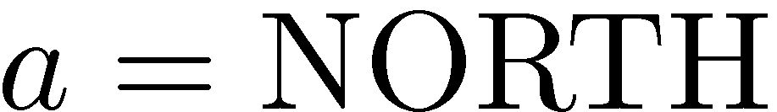
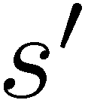
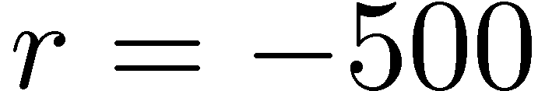
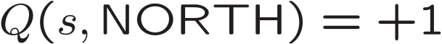
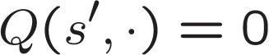
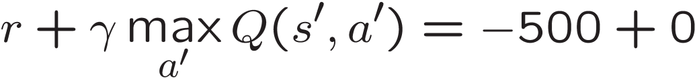
Example: Q-Pacman
[Demo: approximate Q-learning pacman (L11D10)]

Slide 34
Demo Approximate Q-Learning -- Pacman

Slide 35
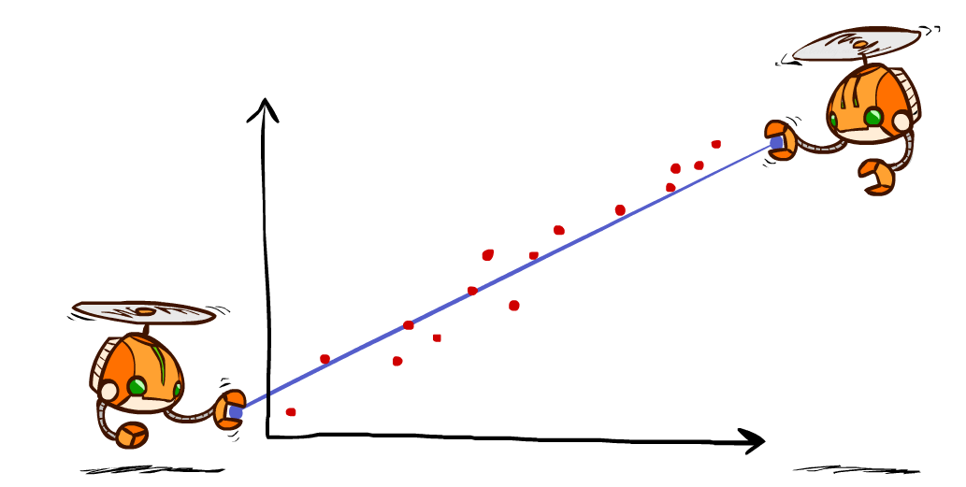
Q-Learning and Least Squares
Notes:
DK :57 in, :17 to go

Slide 36

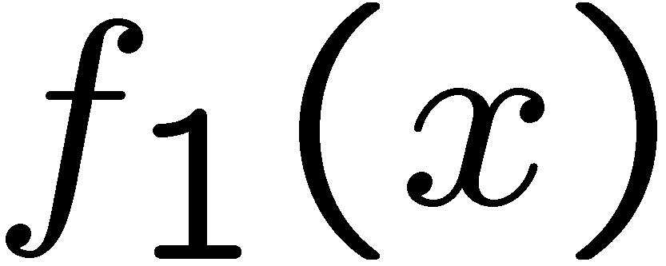
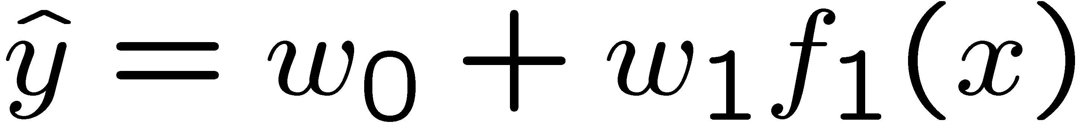
Linear Approximation: Regression
40
26
24
20
22
20
30
20
40
0
0
20
30
10
20
0
10
0
Prediction:
Prediction:
Notes:
Figure 1: scatter(1:20,10+(1:20)+2*randn(1,20),'k','filled'); a=axis; a(3)=0; axis(a);

Slide 37
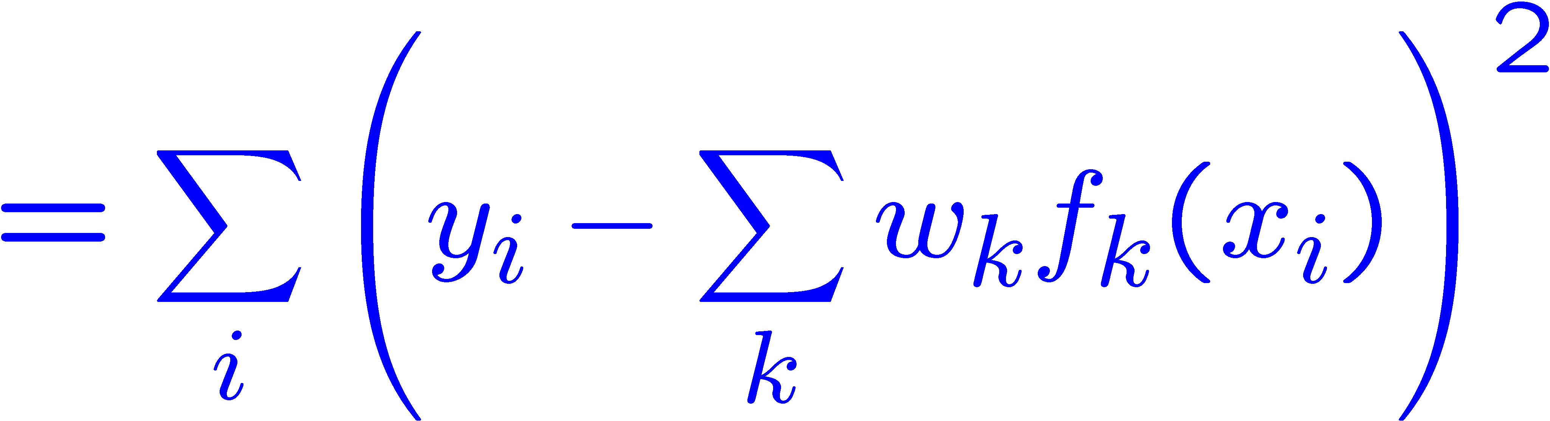
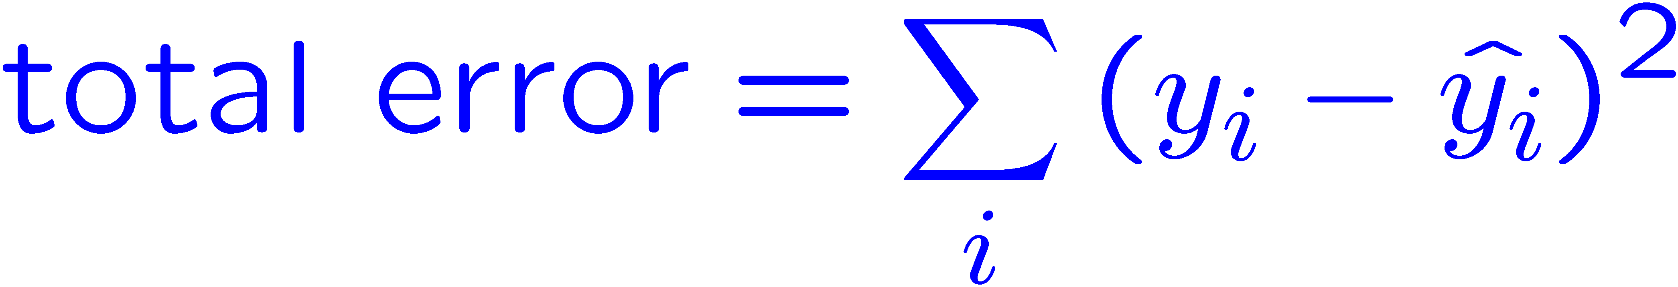
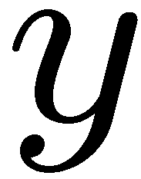


Optimization: Least Squares
Error or “residual”
Observation
Prediction
0
0
20
Notes:
Figure 1: scatter(1:20,10+(1:20)+2*randn(1,20),'k','filled'); a=axis; a(3)=0; axis(a);

Slide 38
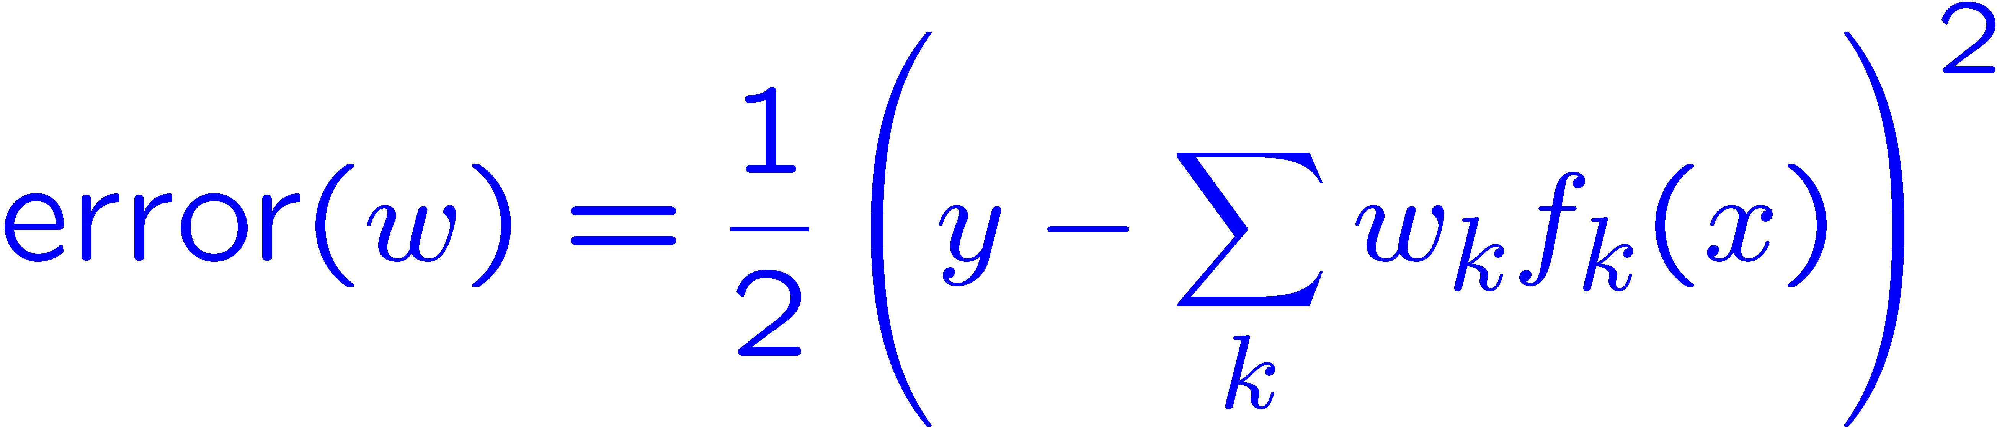
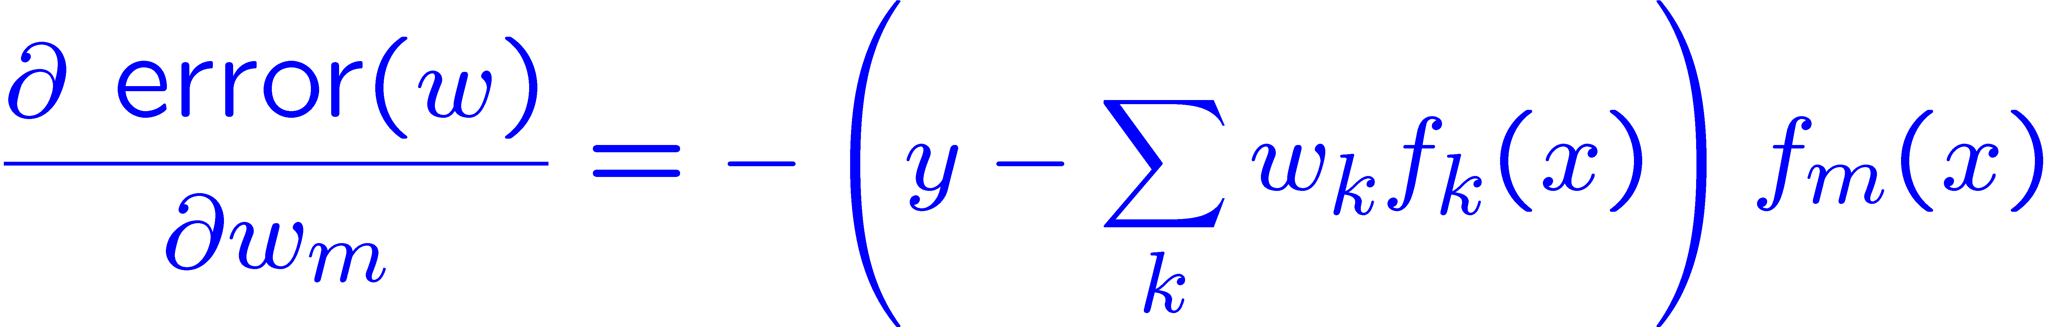
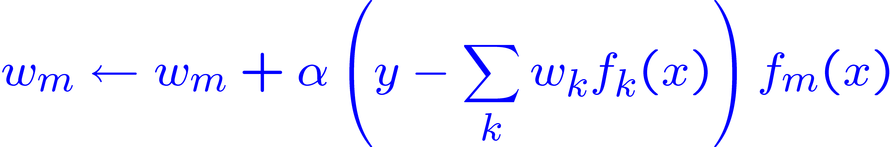
Minimizing Error
Imagine we had only one point x, with features f(x), target value y, and weights w:
Approximate q update explained:
“target”
“prediction”

Slide 39
Recent Reinforcement Learning Milestones

Slide 40
TDGammon
1992 by Gerald Tesauro, IBM
4-ply lookahead using V(s) trained from 1,500,000 games of self-play
3 hidden layers, ~100 units each
Input: contents of each location plus several handcrafted features
Experimental results:
Plays approximately at parity with world champion
Led to radical changes in the way humans play backgammon

Slide 41
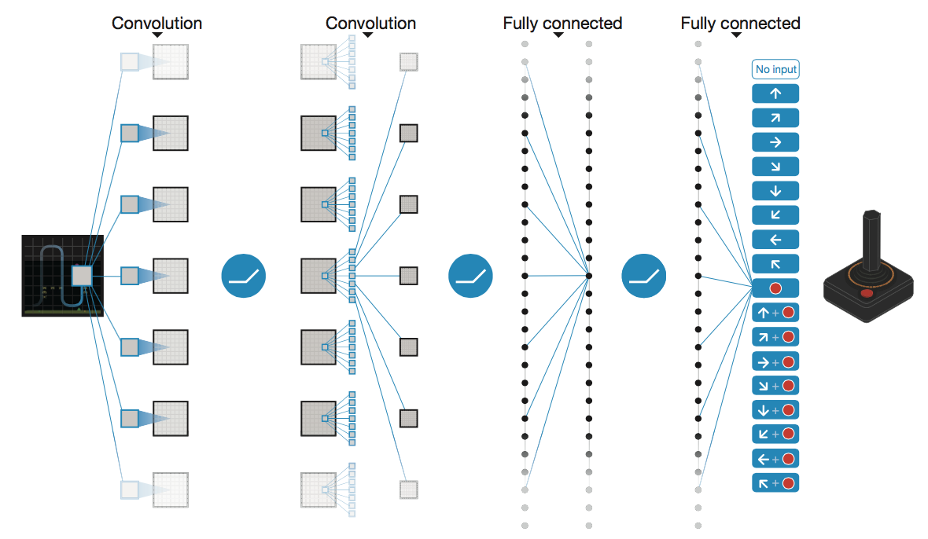
Deep Q-Networks
Deep Mind, 2015
Used a deep learning network to represent Q:
Input is last 4 images (84x84 pixel values) plus score
49 Atari games, incl. Breakout, Space Invaders, Seaquest, Enduro

Slide 42
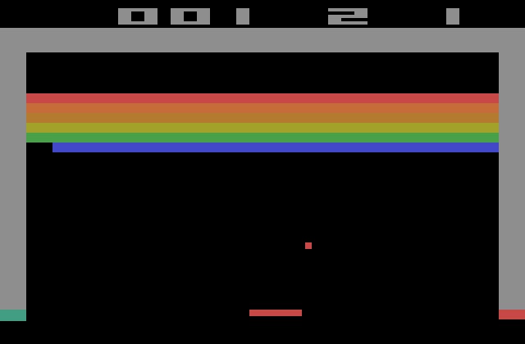
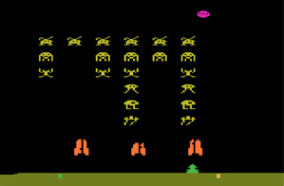
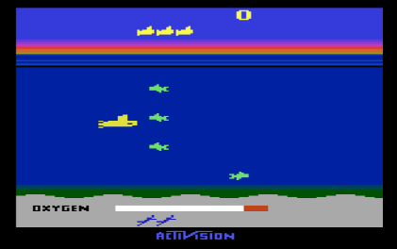
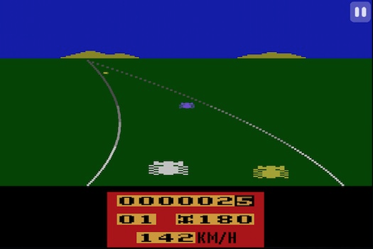

Slide 43




OpenAI Gym
2016+
Benchmark problems for learning agents
https://gym.openai.com/envs

Slide 44

AlphaGo, AlphaZero
Deep Mind, 2016+

Slide 45
Autonomous Vehicles?

